Slide 1
Use of the soft skills function on the tool

Slide 2
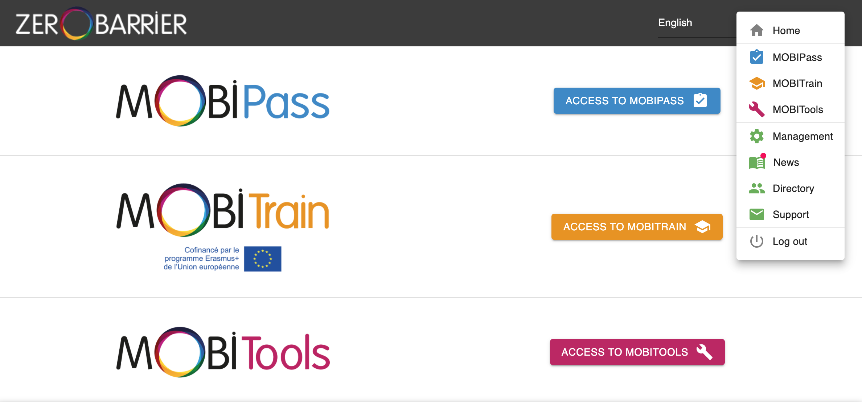
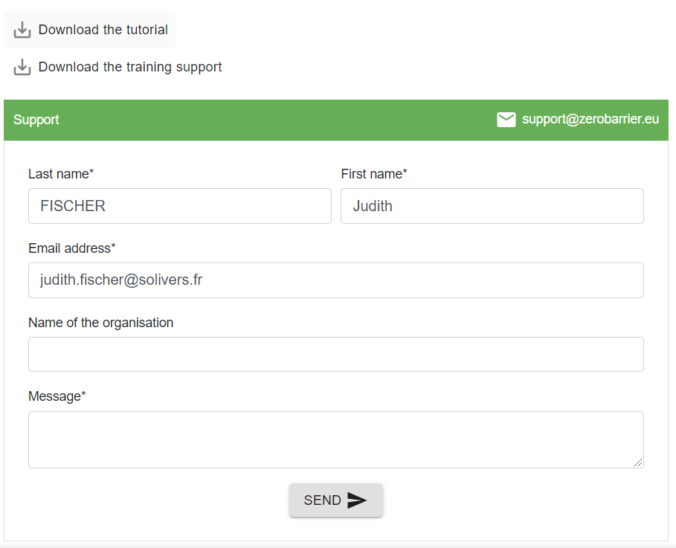
General functions of Zerobarrier
You can find a tutorial on the general functions of Zerobarrier online : click on « Menu » & on « Support ». Then, simply download the tutorial

Slide 3
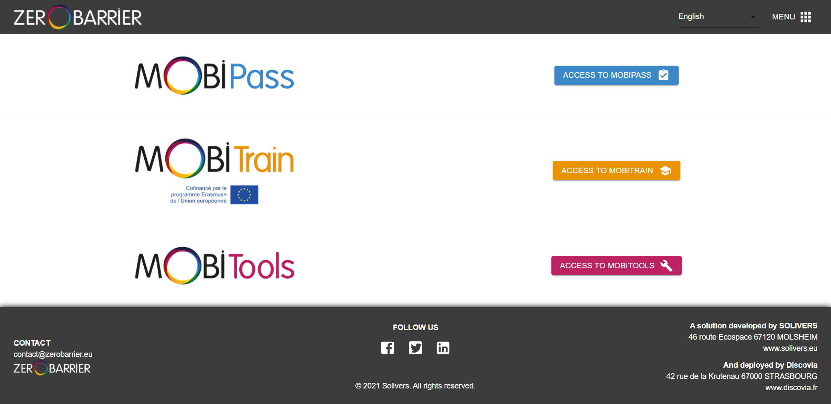
The platform is divided into 3 parts

Slide 4
On Mobipass, it is possible to consult the occupational standards linked to soft skills as weel as the Soft skills occupational standard. At the same time it is possible to record the results of placements and assessments, to consult and visualize them and to automaticaly generate CVs ans skills portfolio.
On the followed pages you will learn how to :
Access MOBIPASS
Access the different soft skills modules
Consult the entire soft skills database
Save initial placements
Consult initial placements results
Record assessments
View assessments results
Record assessments through an ECVET occupational standards
View the ECVET occupational standard linked to soft skills
Generate Cv’s and skill portfolio

Slide 5
ACCESS MOBIPASS
After you have registered, click on ACCESS TO MOBIPASS

Slide 6
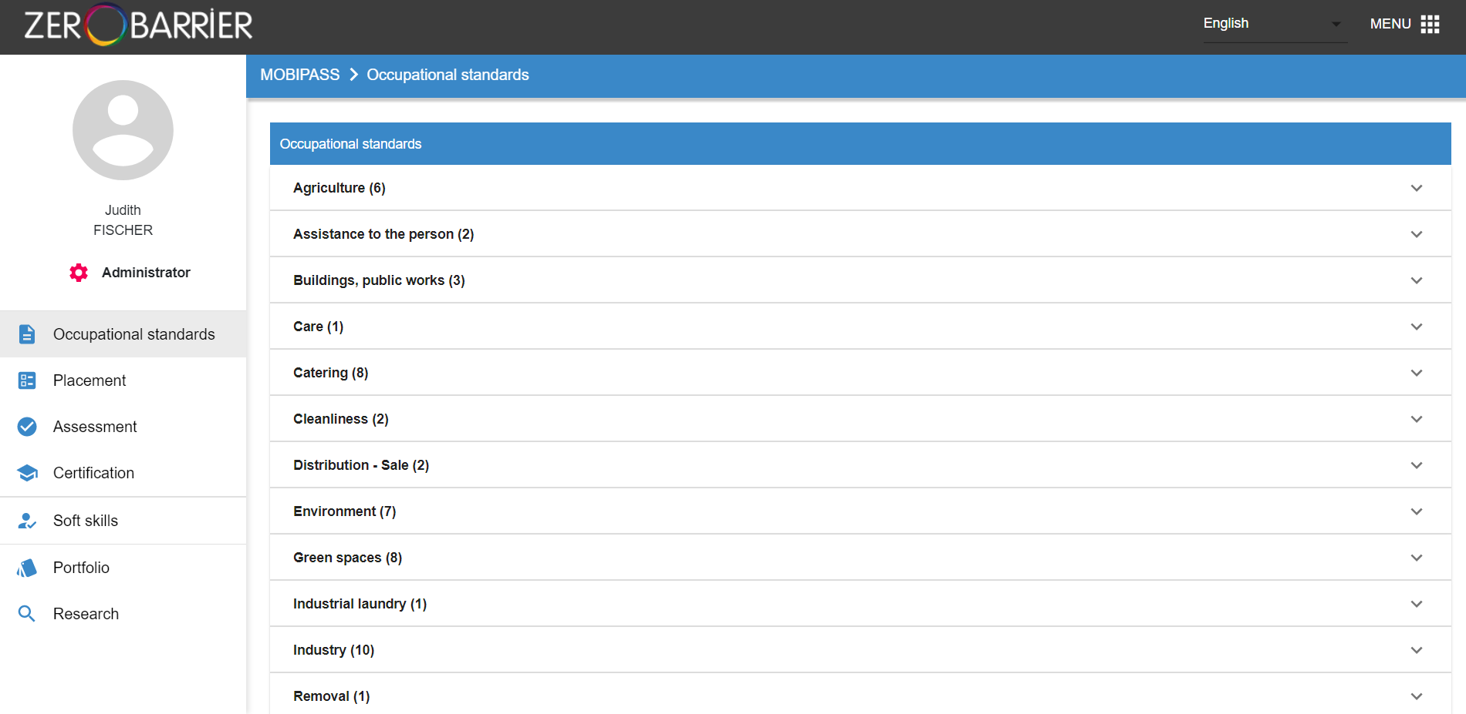
ACCESS THE DIFFERENT SOFT SKILLS MODULES
To visualize the soft skills modules:
1. Click on the Soft skills tab in the left menu

Slide 7
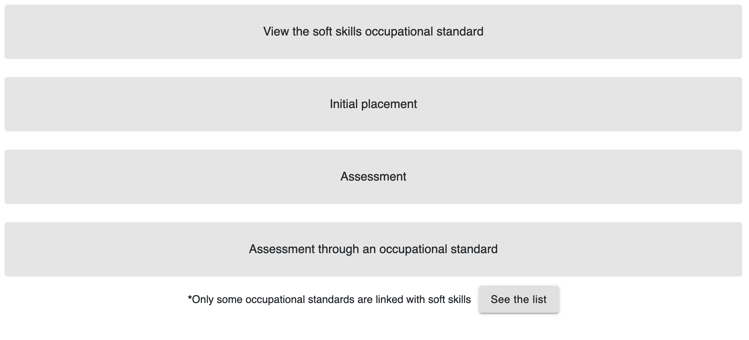
You will find this different modules:
Consult the entire soft skills database
Save initial placements
Consult initial placements results
Record assessments
View assessments results
Record assessments through an ECVET occupational standard
View the ECVET occupational standards linked to soft skills

Slide 8
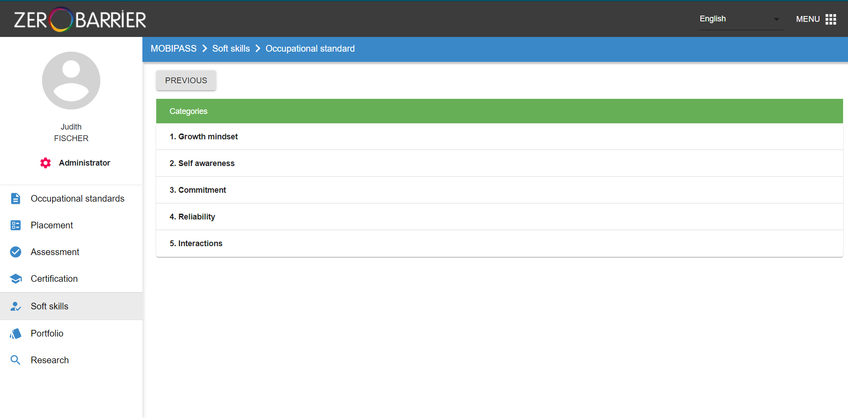
CONSULT THE ENTIRE SOFT SKILLS DATABASE
1. Click on the tab “View the soft skills occupational standard”
You will arrive on this page where you only visualize the 5 categories of soft skills
The 5 categories of soft skills

Slide 9
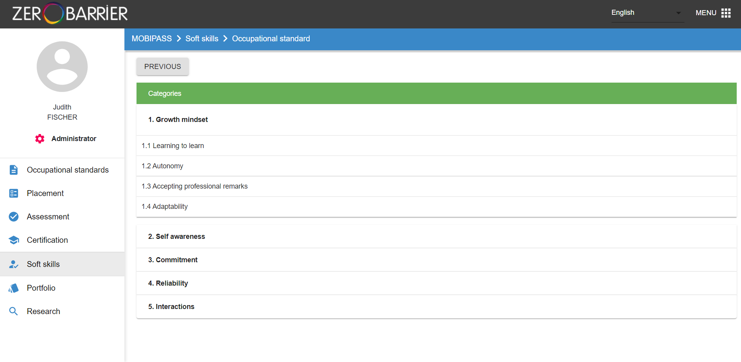
2. Click on the name of the soft skills category you want to view
A menu opens allowing you to view all the soft skills contained in this category

Slide 10
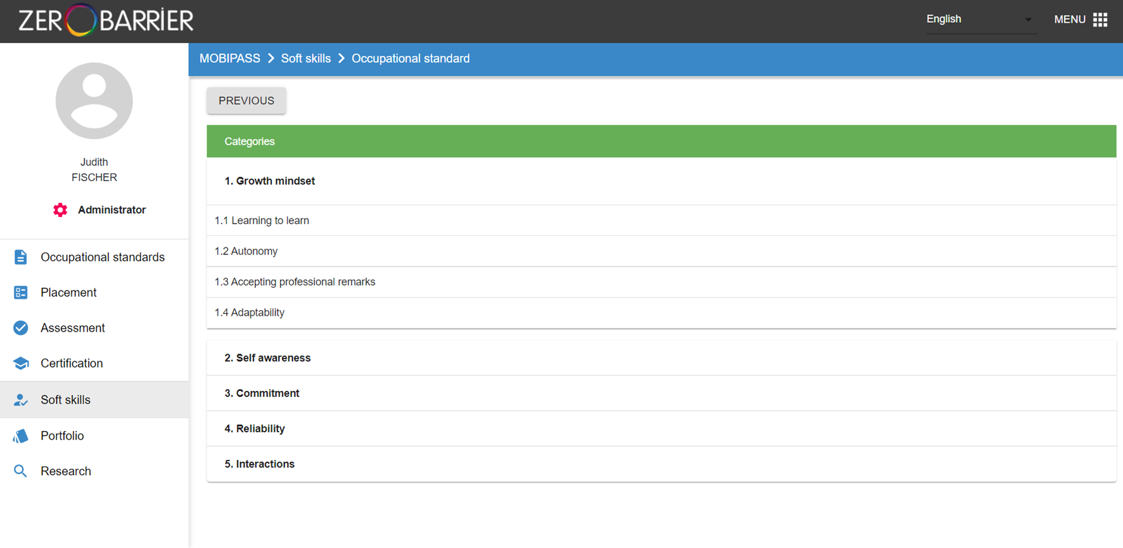
Click on the name of the soft skill to view the details of the different levels

Slide 11
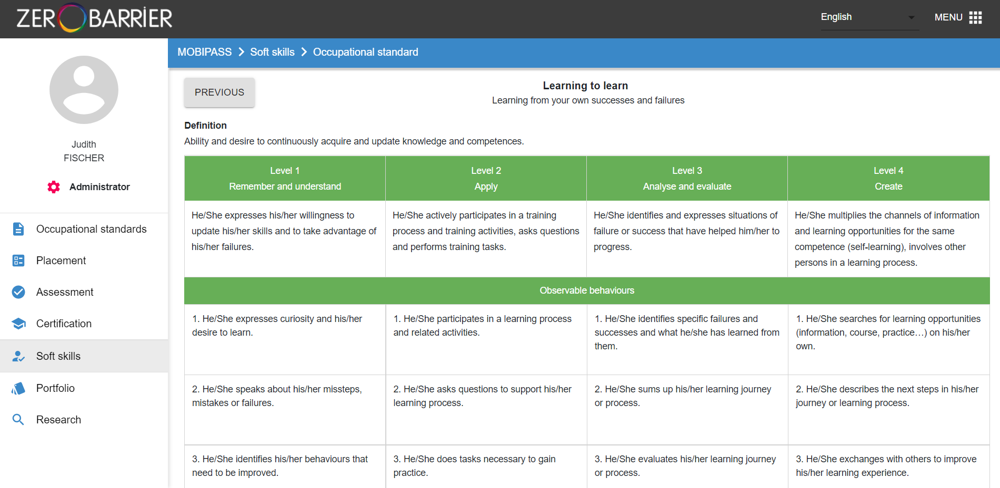
View the 4 levels of the soft skill
Drag the scroll bar to read all the observable behaviours
4
5

Slide 12
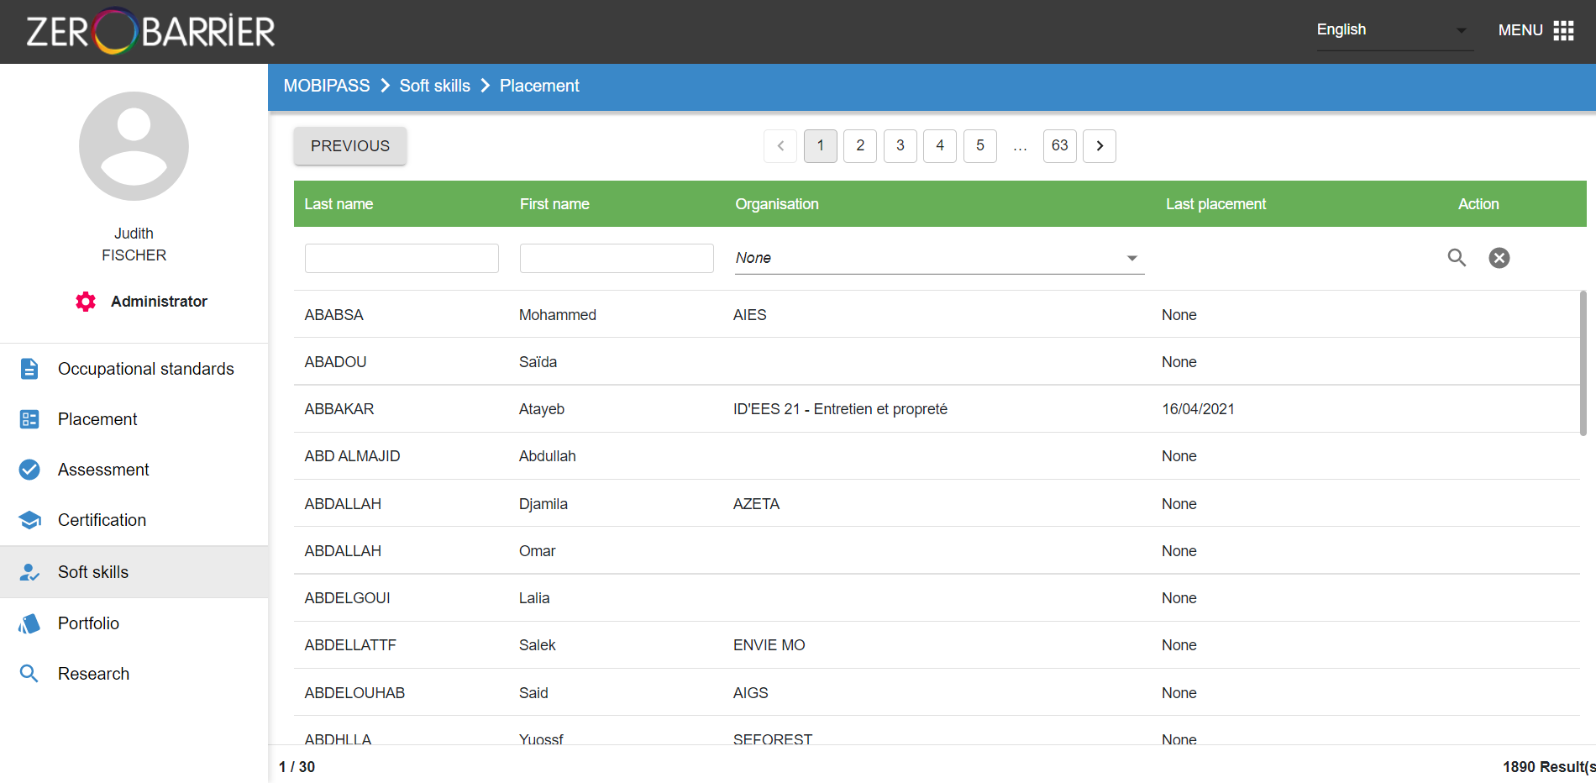
SAVE INITIAL PLACEMENTS
Click on the tab « Initial placement » : You will arrive on this page
Choose the trainee you want to do the placement with by clicking on their name
2
NAME 1
First name 1
Name of the organisation
NAME 2
First name 2
Name of the organisation
NAME 3
First name 3
Name of the organisation

Slide 13
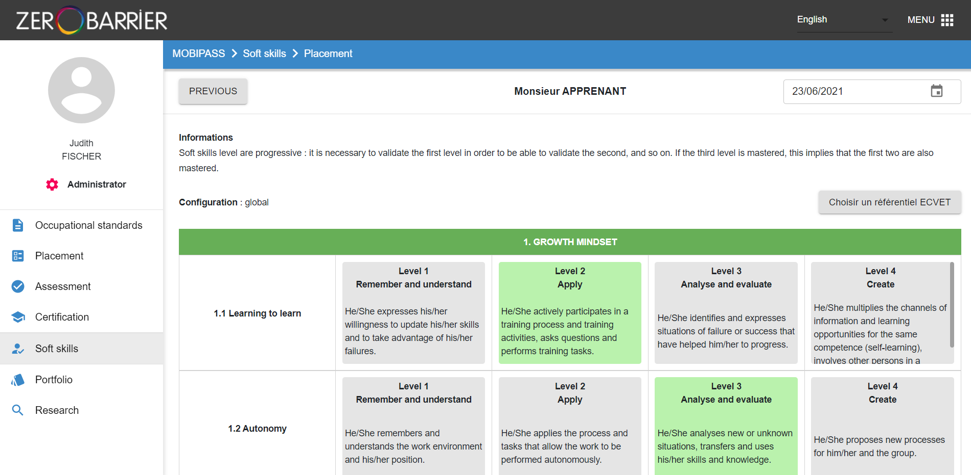
Choose the date of the initial placement, by default the tool will record the current date
Click on the soft skills levels on which you want to place the trainee (once selected the soft skills level turns green)
Drag the scroll bar to read the entire soft skills database to place the trainee on all or part of the soft skills
3
4
5

Slide 14
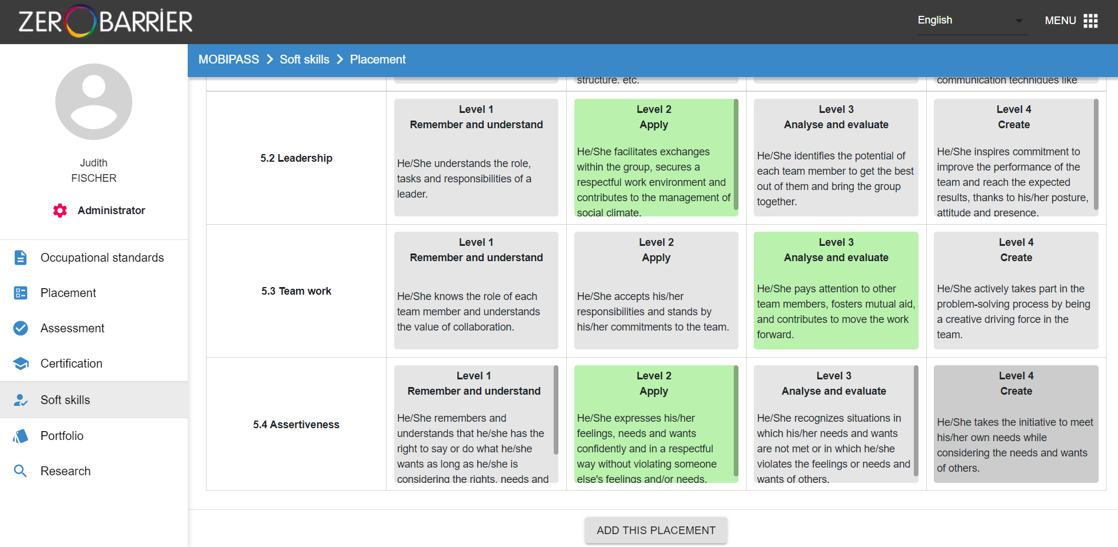
Once the placement is done and you have arrived at the bottom of the page (with the scroll bar) you can save the placement by clicking on “ADD THIS PLACEMENT"

Slide 15
CONSULT INITIAL PLACEMENT
1. Stay on the tab “Initial placement” : on this page it’s possible to filter the initial placements by name or first name
You must fill in the desired field (name or first name) and click on the search icon
NAME 1
First name 1
Name of the organisation
NAME 2
First name 2
Name of the organisation
NAME 3
First name 3
Name of the organisation

Slide 16
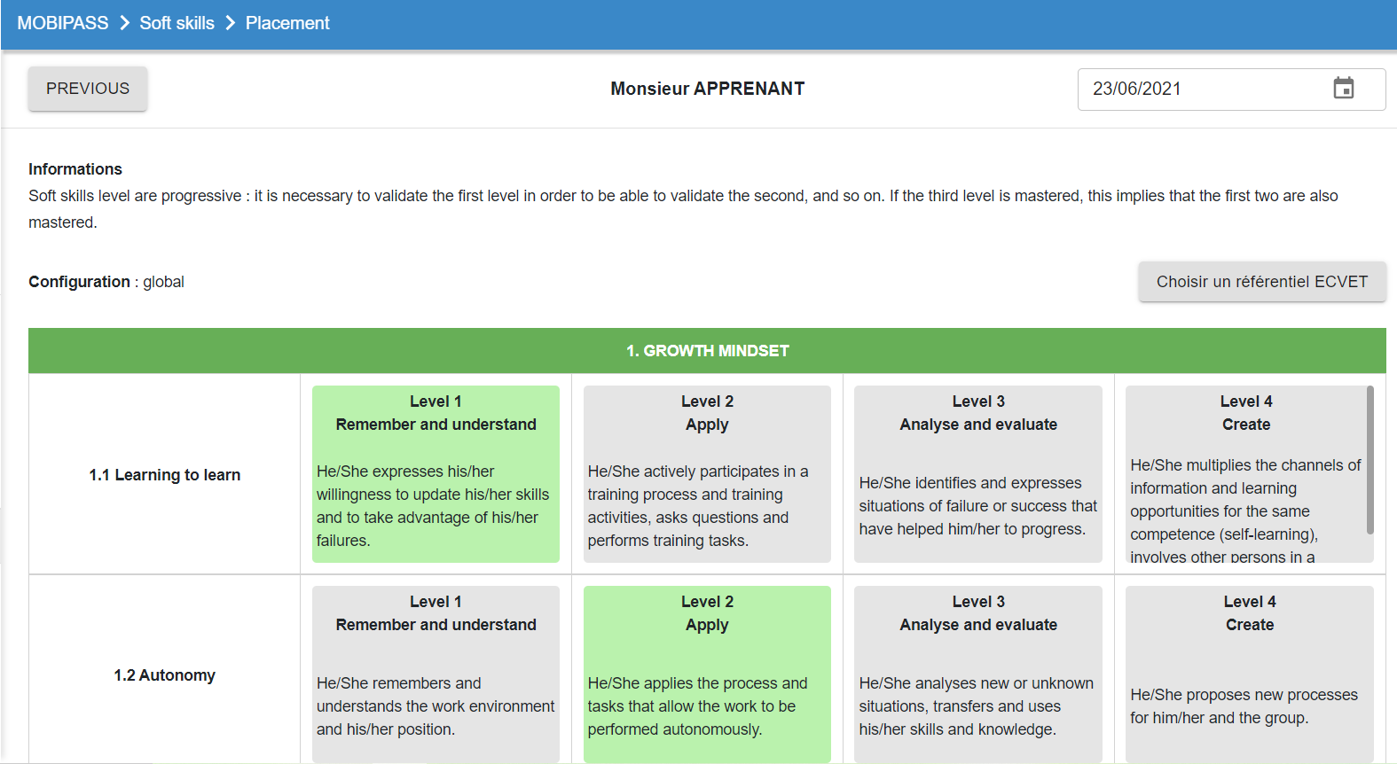
To view the details of a trainee’s initial placement, click on the name of the placement
To delete a placement click on
1
2
When you click on the name of the initial placement a new window opens
with initial placement details
Drag the scroll bar to view the entire initial placement
3

Slide 17
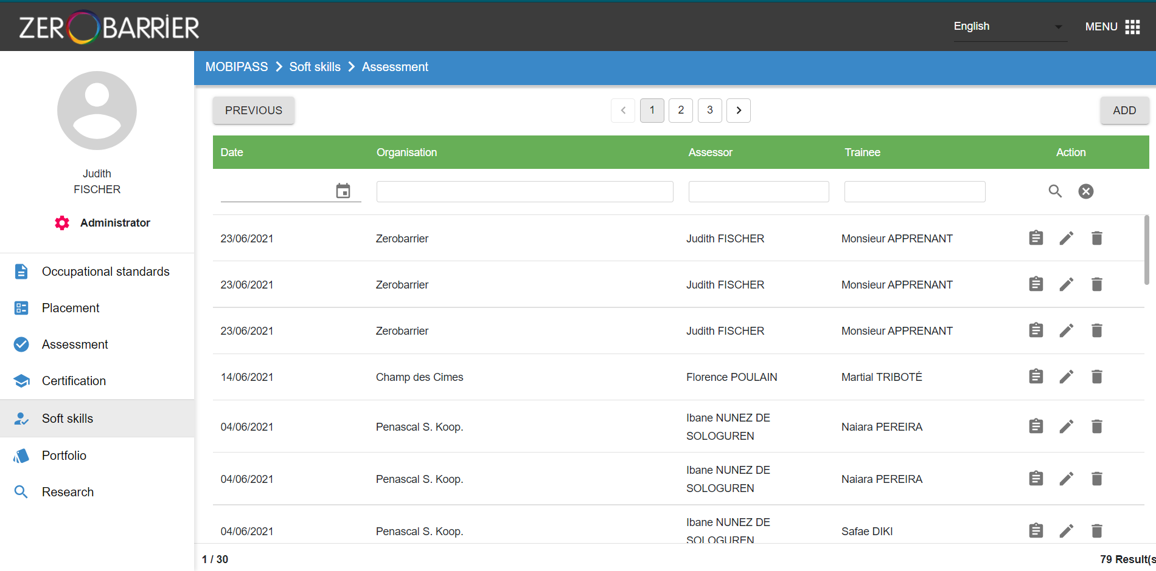
RECORD ASSESSMENTS
Click on the tab « Assessment »
To save a new assessment, click on « ADD »
2
Etablissement A
Monsieur Tuteur
Apprenant 1
Etablissement A
Madame Tutrice
Apprenant 2
Etablissement A
Madame Tutrice
Apprenant 3
Etablissement A
Monsieur Tuteur
Apprenant 4
Etablissement A
Madame Tutrice
Apprenant 5
Etablissement A
Monsieur Tuteur
Apprenant 6
Etablissement A
Madame Tutrice
Apprenant 7

Slide 18
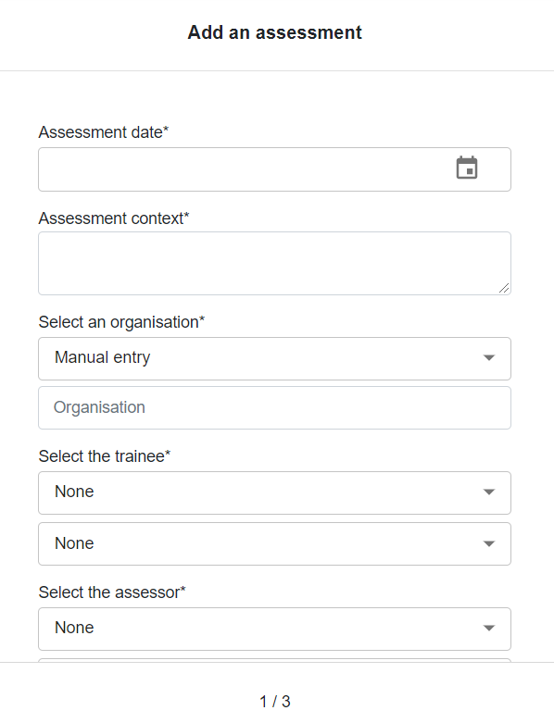
Fill in the general information either by manual entry or with the help of the drop-down menus
Click on to access each new screen
Page 2 of the assessment recording form
Page 1 of the assessment recording form

Slide 19
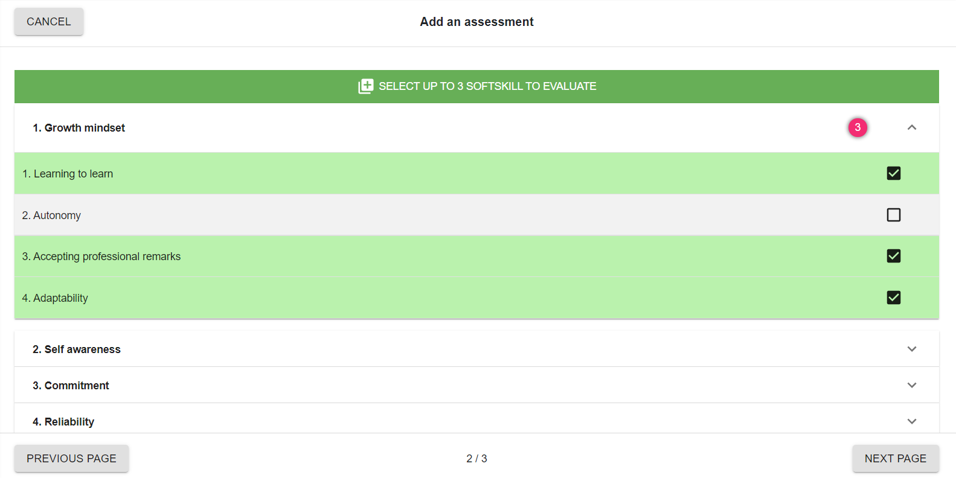
5. You can select a maximum of 3 soft skills to be assessed. To view the soft skills, click on the drop-down menu arrow
6. Click on to access the last screen
7. Click on to access the next screen
Page 3 of the assessment recording form
6
7

Slide 20
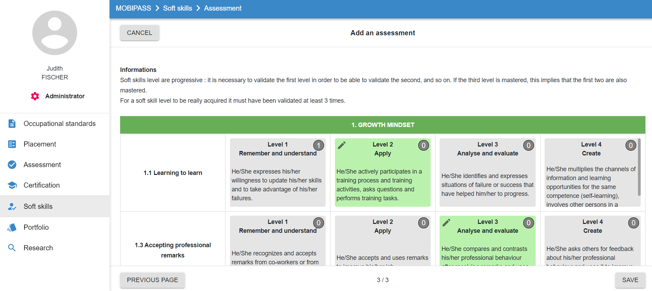
8. Evaluate at which level of each of the 3 soft skills your trainee is by clicking on the observed level. Once selected, the level appears in green
9. Click on to delete the assessment
10. Click on to record the assessment
9
10

Slide 21
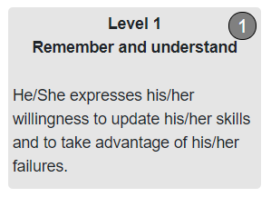
REMINDER : ASSESSMENT METHOD
The document “SOFT SKILLS PLACEMENT AND ASSESSMENT PROTOCOL" explain the whole method of placement and assessment. You can download it in the menu
A level of Soft skills is considered to be acquired when at least one corresponding observable behaviour has been observed 3 times by the trainer / technical supervisor / tutor / assessor in different contexts.
During the assessment, the figure indicates to the evaluator how many times this soft skill has already been evaluated
For example this app has already been rated 1 time

Slide 22
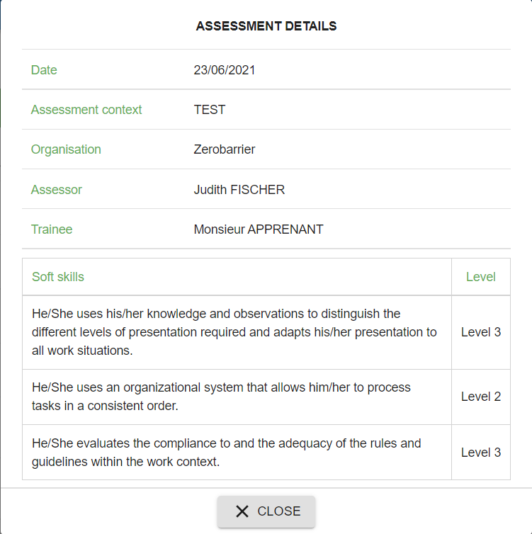
VIEW ASSESSMENTS RESULTS
Stay on the tab “Assessment”
You can view the history of the assessments carried out in an organisation
You can see the details and edit or delete the assessments you have recorded.
Organisation
Monsieur Tuteur
Apprenant 1
2
Organisation
Madame Tutrice
Apprenant 2
Organisation
Madame Tutrice
Apprenant 3
Organisation
Monsieur Tuteur
Apprenant 4
Organisation
Madame Tutrice
Apprenant 5
Organisation
Monsieur Tuteur
Apprenant 6
Organisation
Madame Tutrice
Apprenant 7

Slide 23
RECORD ASSESSMENTS THROUGH AN ECVET OCCUPATIONAL STANDARD
By clicking on ”Assessment through an occupational standard”, you will be able to do your soft skills assessment in link with a specific occupational standard . To perform this kind of assessments, we propose you a special tutorial online
To access the tutorial on entering trainee assessments based on an occupational standard, go in the menu, click on “support” and then click on "Download the tutorial"

Slide 24
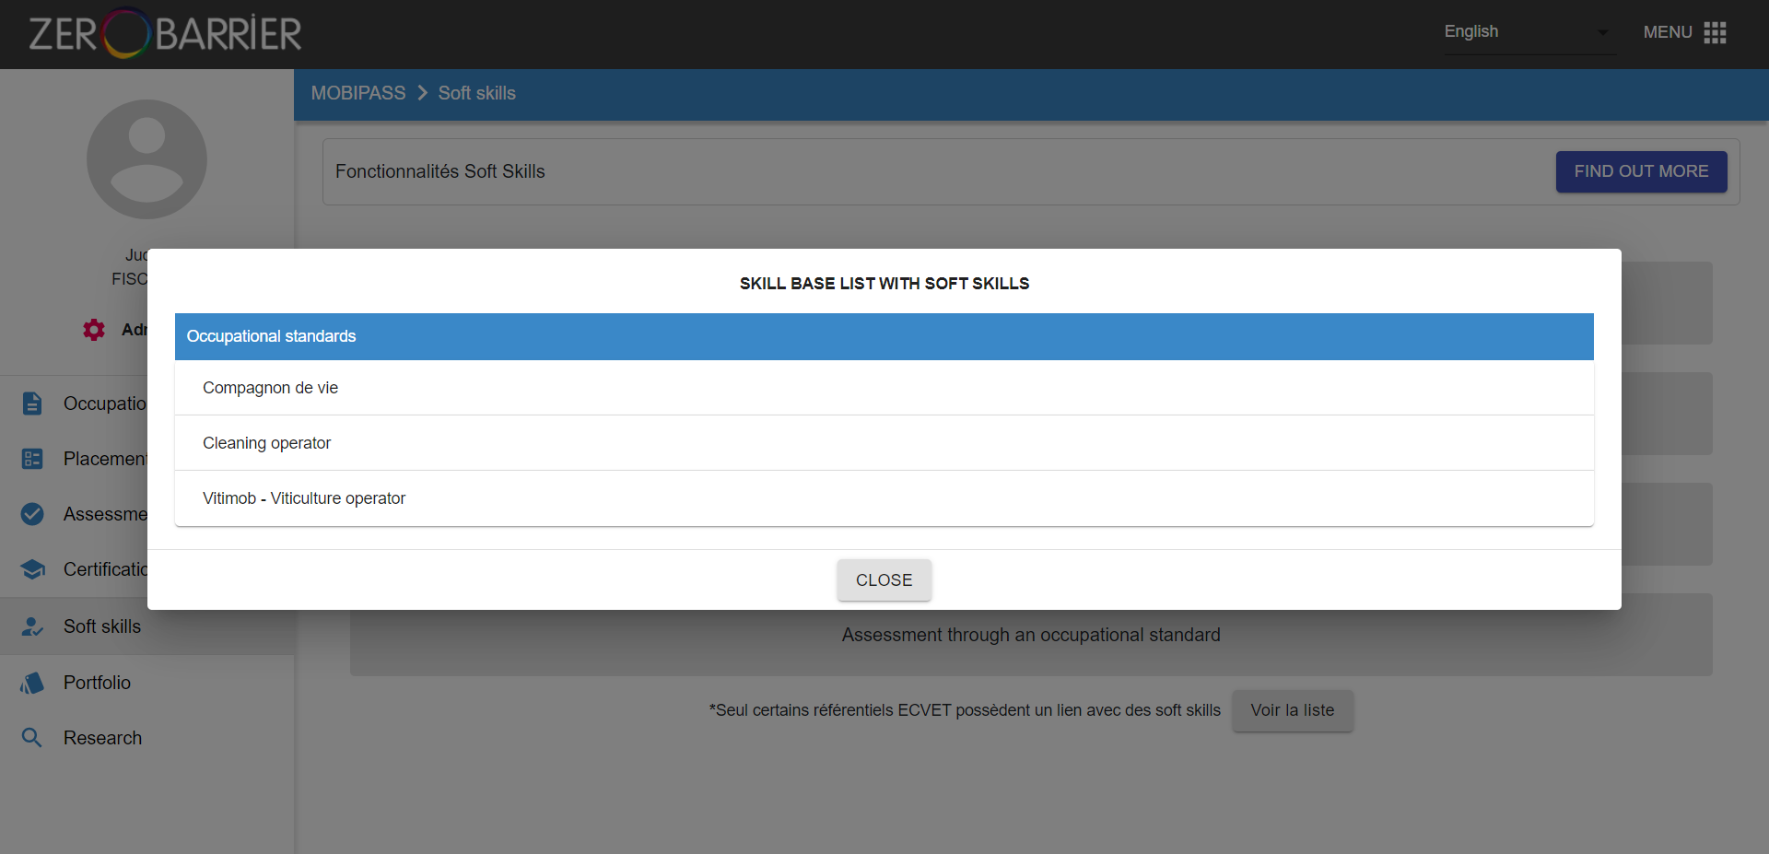
VIEW THE ECVET OCCUPATIONAL STANDARDS LINKED TO SOFT SKILLS
To view the existing occupational standards that have been linked to soft skills, click on
You will arrive on this page where you will find a list of occupational standards linked to soft skills

Slide 25
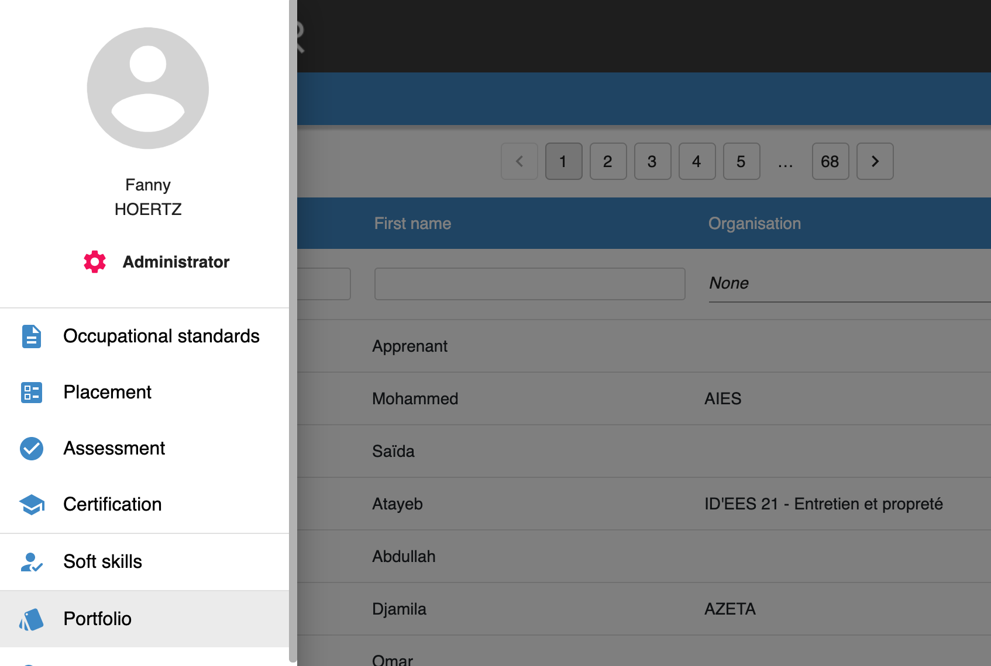
GENRATE CERTIFICATES, SOFT SKILLS PASSPORT s& CV’s
In order to be able to generate certficates, soft skills passports and CV’s, leave the “Soft skills” modules and click on Portfolio

Slide 26
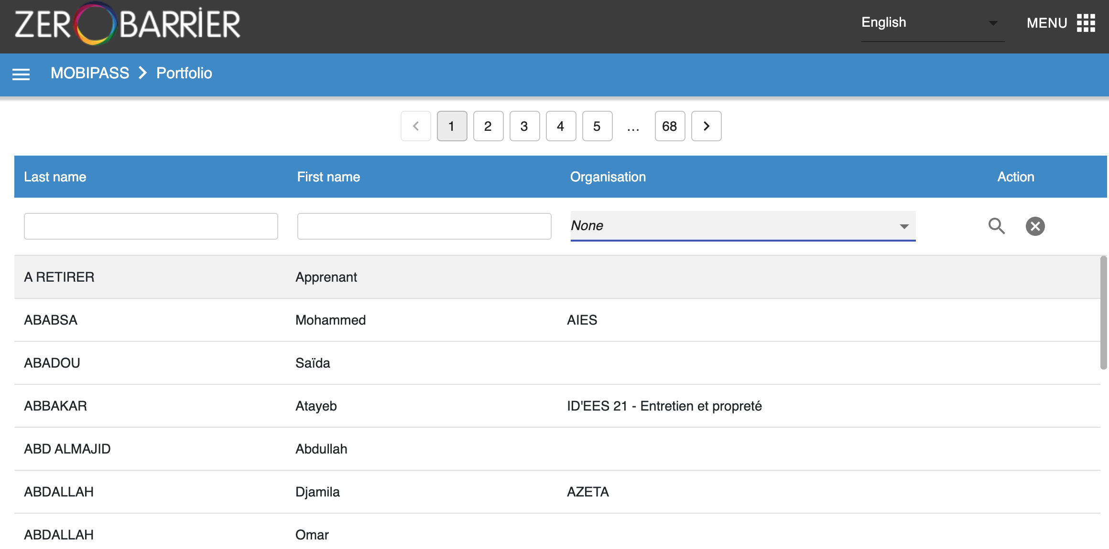
Select the trainee for whom you want to generate this documents. You can search directly his name and surname or you can search by organization. Don’t forget to click on the loop.

Slide 27
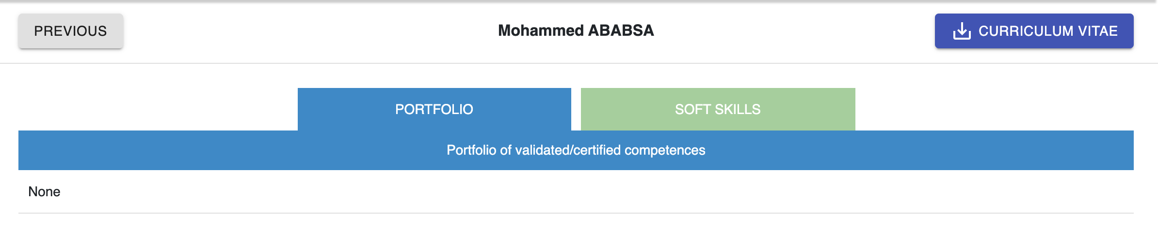
1. Select the trainee for whom you want to generate this documents. You can search directly his name and surname or you can search by organization. Don’t forget to click on the loop and to click on the name of your trainee.
2. You will arrive on this page where you can directly generate a CV, by clicking on “Curriculum vitae”

Slide 28
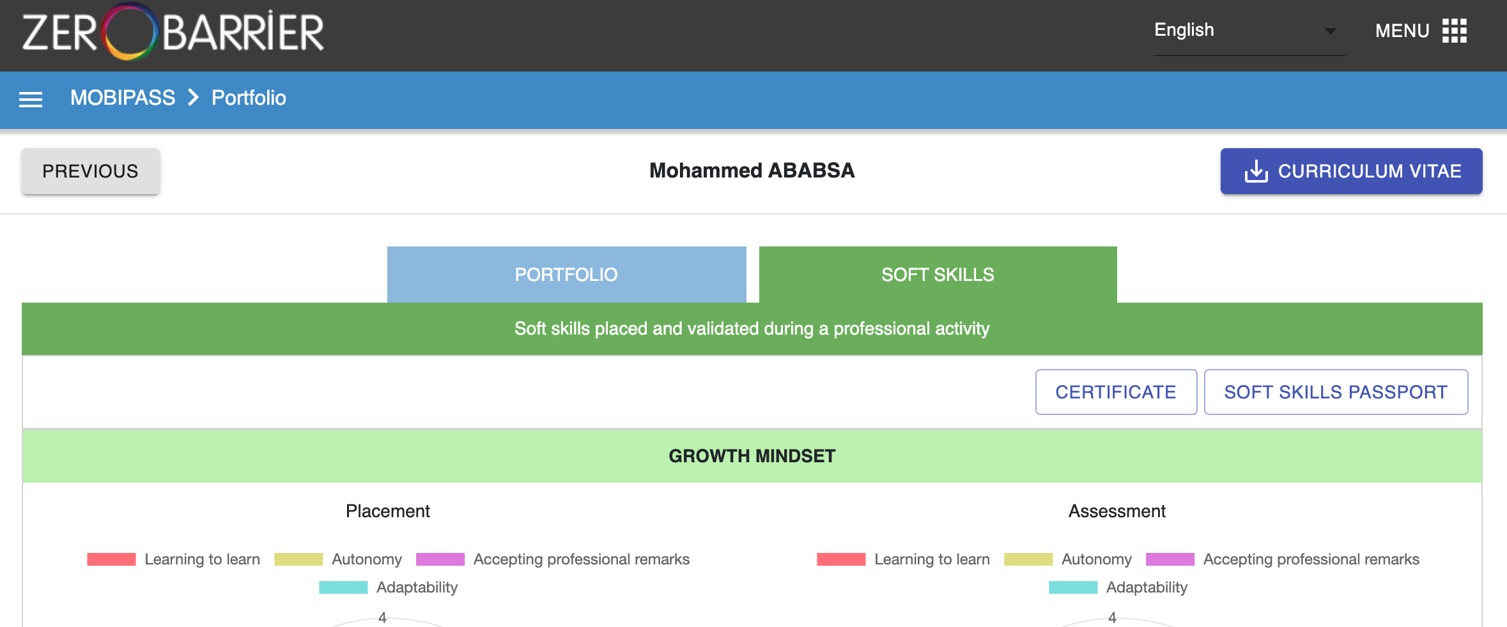
If you want to generate a certificate or a soft skills passport, click on the tab “Soft skills”
You will arrive on this page where you can generate the certificate and the passport

Slide 29
On Mobitrain, it is possible to keep a track of all the training and consolidations followed by each trainee. It is also possible to generate training certificates.
On the followed pages you will learn how to :
Access Mobitrain
Access the soft skills module
Keep a track of a training or a consolidation in a work situation
Generate a training certificate

Slide 30
ACCESS MOBITRAIN
After you have registered, click on ACCESS TO MOBITRAIN

Slide 31
ACCESS THE SOFT SKILLS MODULE
To visualize the soft skills module, click on the Soft skills training tab in the left menu
XX
XX
XX

Slide 32
KEEP A TRACK OF A TRAINING OR A CONSOLIDATION
In order to keep a track of a training (in classroom or online) or of a consolidation in a work situation, please click on « ADD »
XX
XX
XX

Slide 33
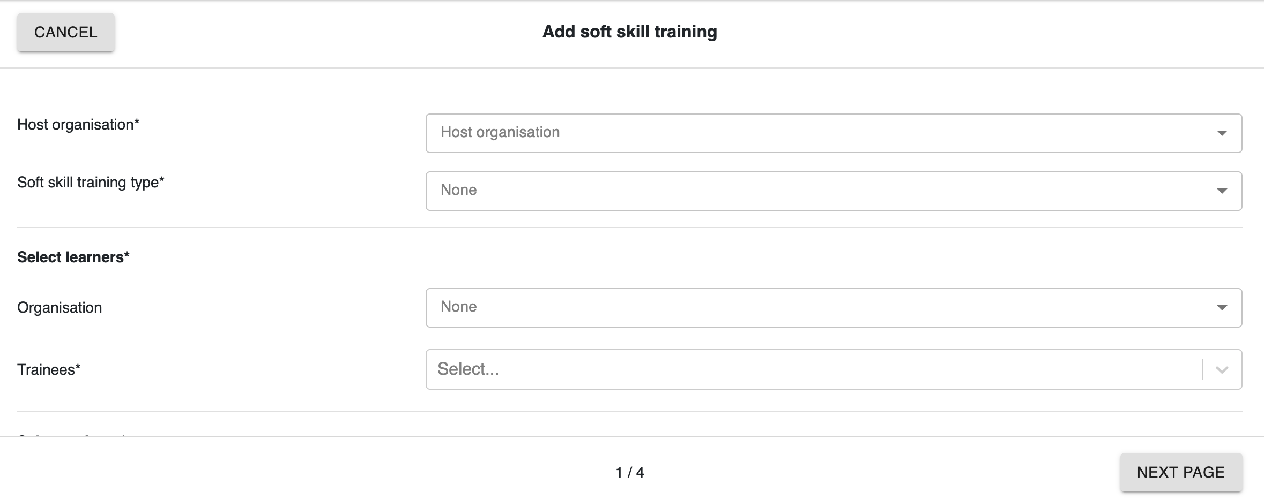
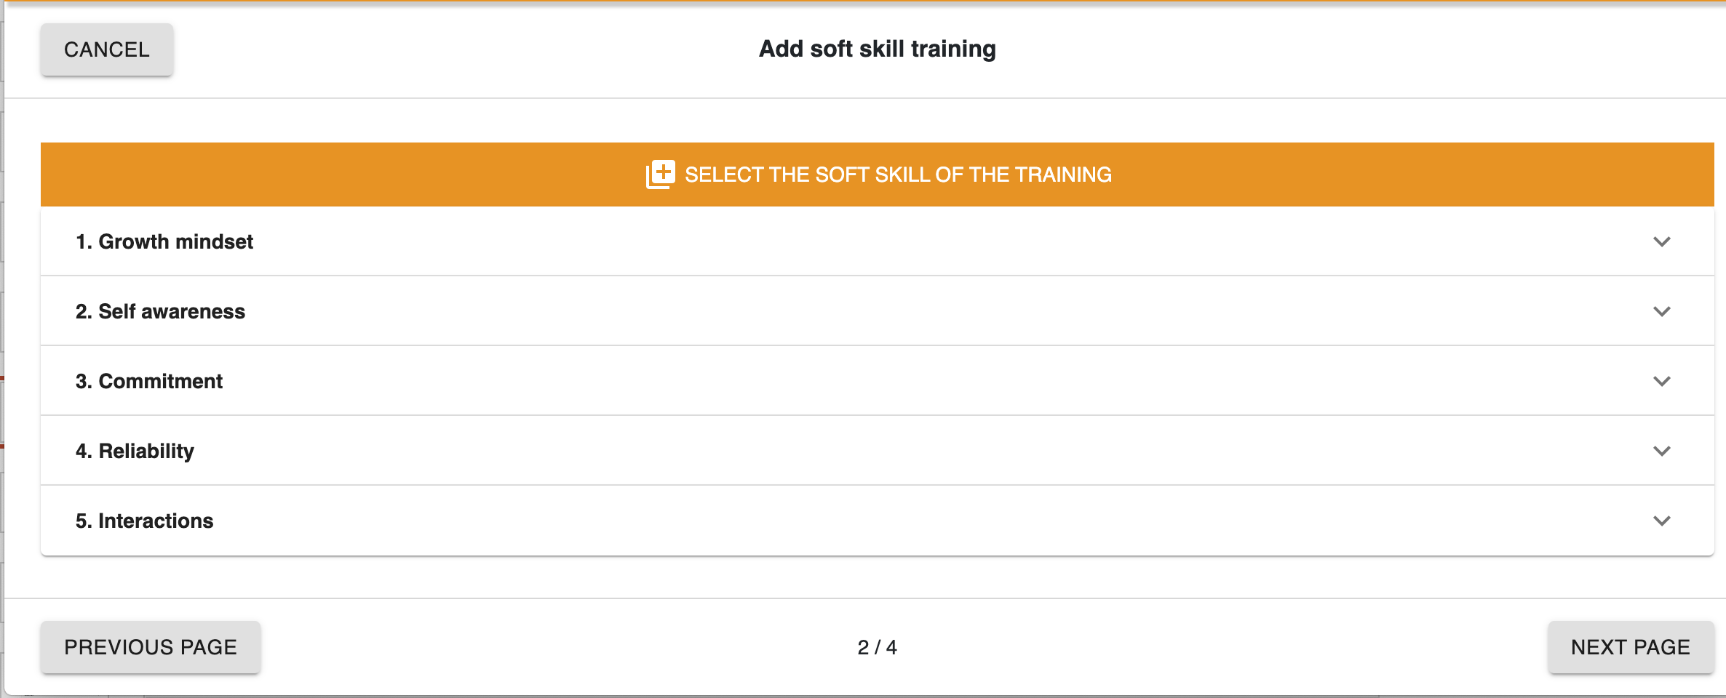
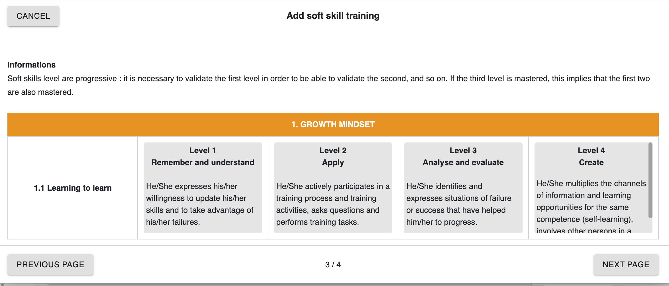
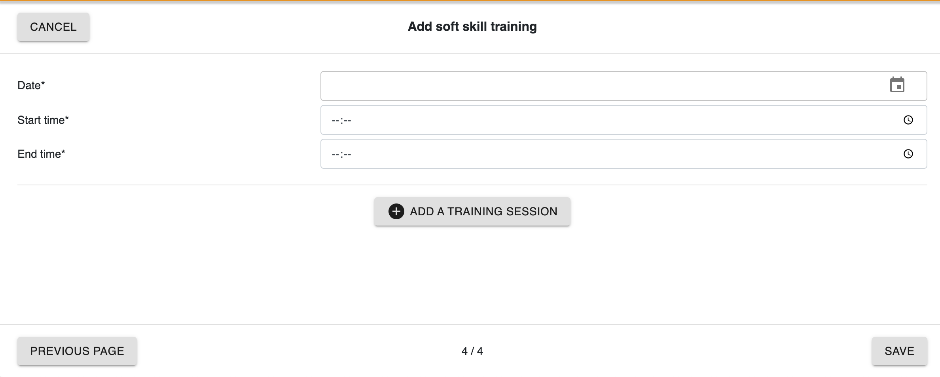
Fill in the necessary informations (Host organisation, Type of trainig, learner, trainer, soft skills, date of the training) and don’t forget to click on « Save »

Slide 34
GENERATE A TRAINING CERTIFICATE
In order to generate a trainig certificate, please click on
XX
XX
XX

Slide 35
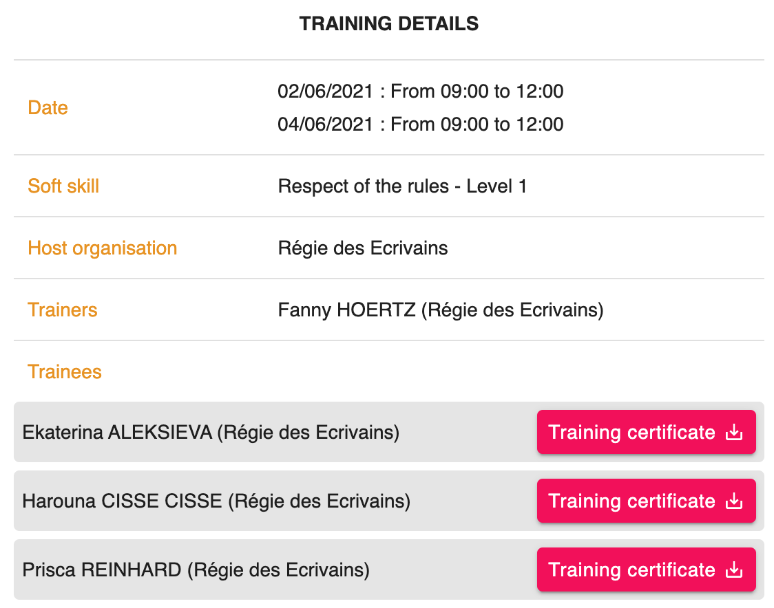
GENERATE A TRAINING CERTIFICATE
You will arrive on this page. You then just need to generate the training certificate by clicking on
XXX
XXX
XXX

Slide 36
On Mobitools, you can find all the different documents and tools that have been developped during the Erasmus + Soft Skills project. For example the European catalogue of soft skills references, the training kit, the toolcards to train soft skills, the placement and assessment protocol etc. …
On the followed pages you will learn how to :
Access Mobitools
Access the soft skills module
Consult all the tool cards
Consult all the other documents

Slide 37
ACCESS MOBITOOLS
After you have registered, click on ACCESS TO MOBITOOLS

Slide 38
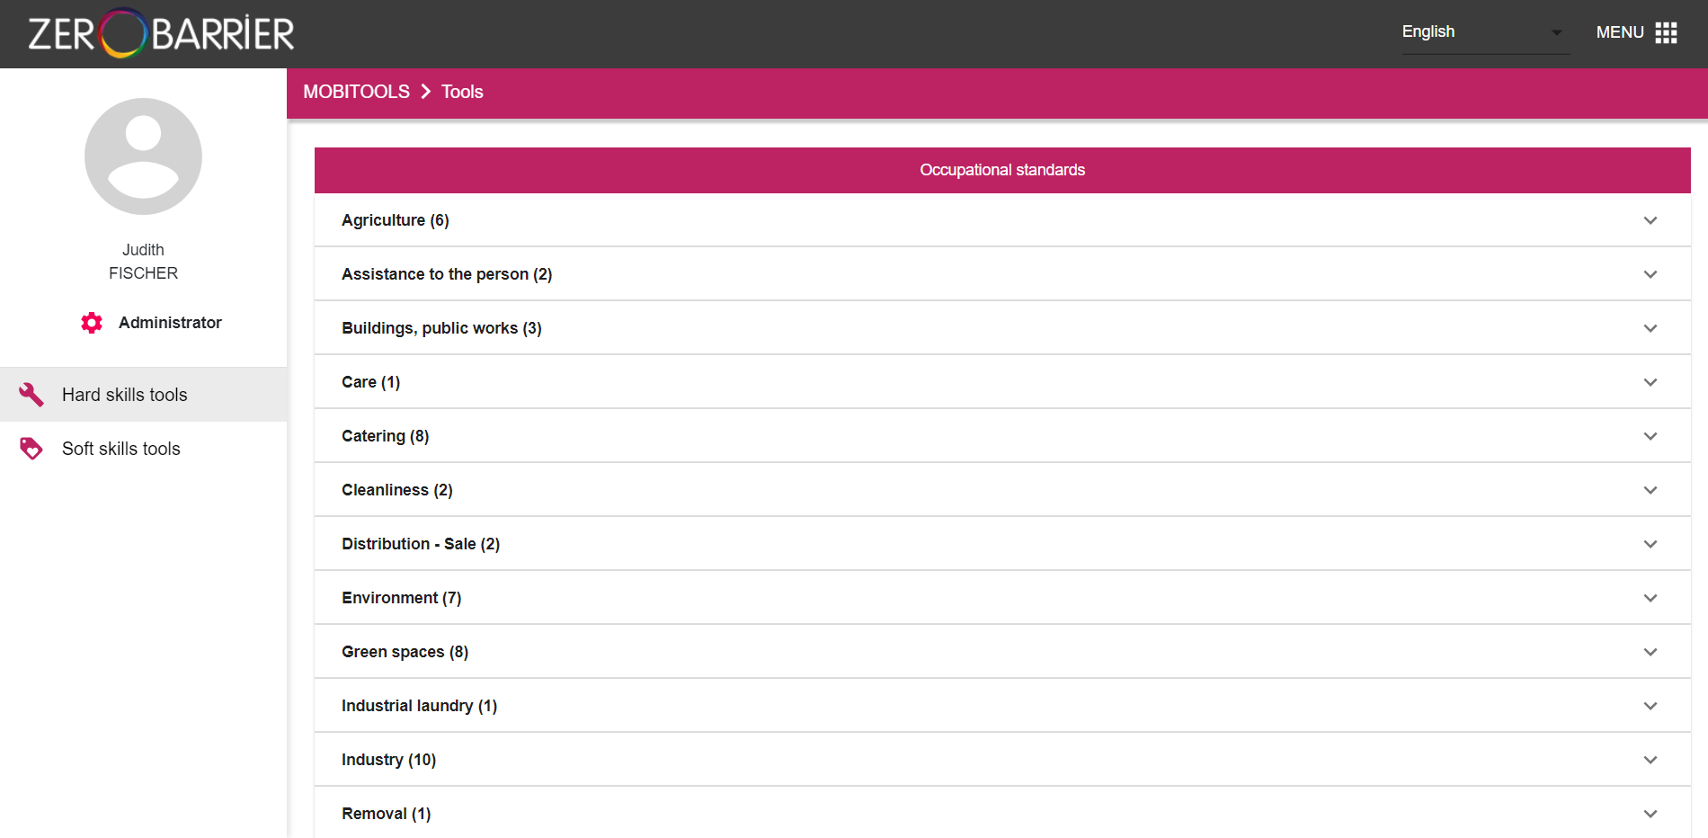
ACCESS THE SOFT SKILLS MODULE
To view all resources and tools related to soft skills, click on the Soft skills tab in the left menu

Slide 39
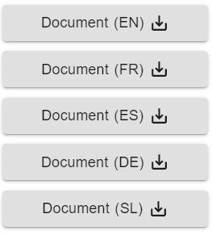
You will arrive on the followed page composed of 2 tabs : Tool cards & Other documentation
Consult all the tool cards
By clicking on this tab, you can consult all the 88 toolcards that have been developed during the project and that can be used to train in soft skills. These tools require some equipment and can be easily adapted to different contexts.
Consult all the other documents
By clicking on this tab, you can consult other resources that have been developed to facilitate the appropriation of the Soft skills project by trainers, technical supervisors, tutors and assessors and to enable them to train and assess soft skills autonomously and independently.
The documents and toolcards are available in different languages ​​(English, French, Spanish, German, Slovenian)

Slide 40
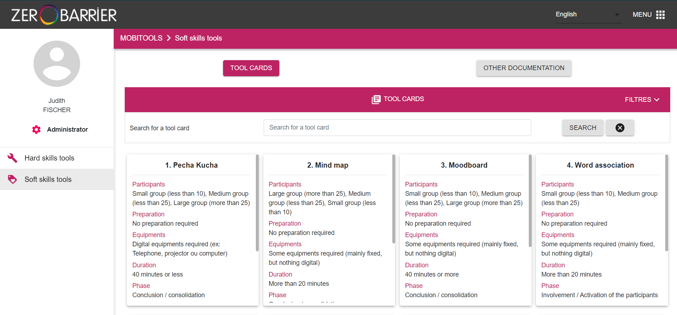
CONSULT ALL THE TOOL CARDS
You can view on this page all the tool cards available to facilitate your training
Slide the scroll bar on each of the tool sheets in order to read all the information related to it (number of participants, preparation, equipment, duration, phase, level, audience and documents to download)
Drag the scroll bar to view all the tool sheets. The database of tool sheets consists of 88 proposals
1
2

Slide 41
You can search for a tool using the "Find a tool card" menu
To start the search click on
3
4

Slide 42
5. You can use filters to search for specific tools using the ”Filters" menu
5

Slide 43
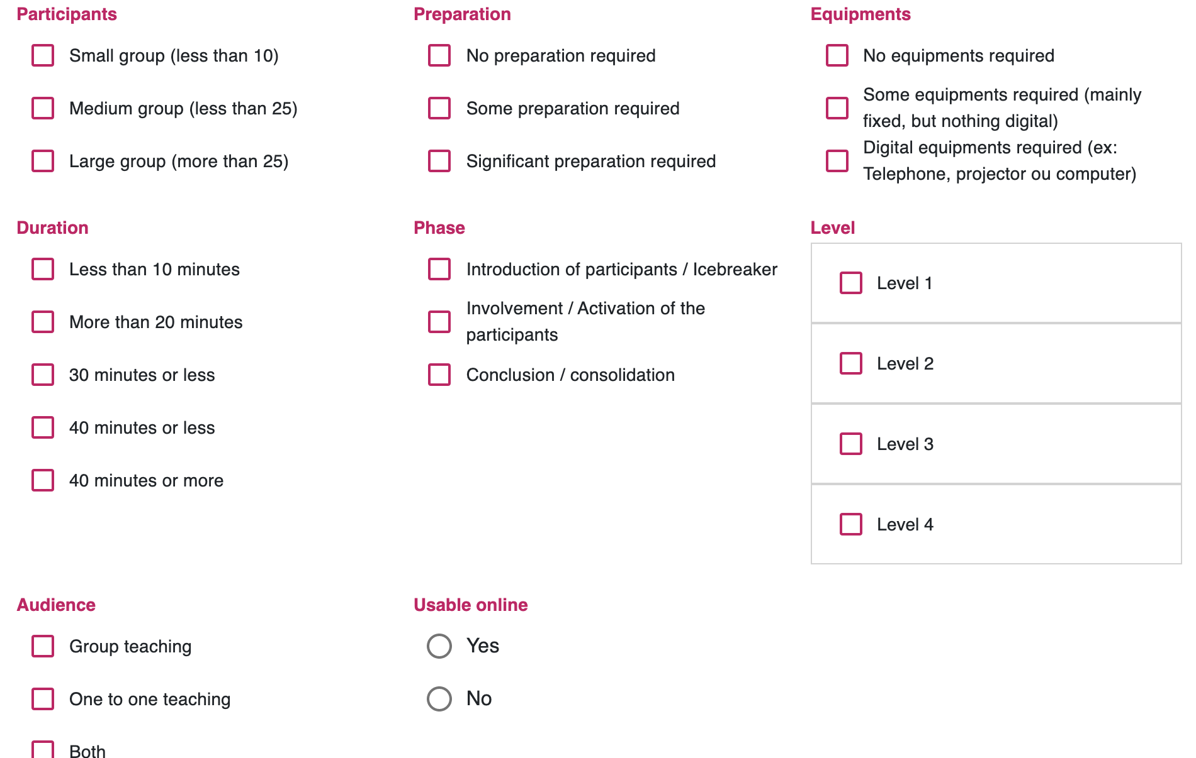
8 Different Filters

Slide 44
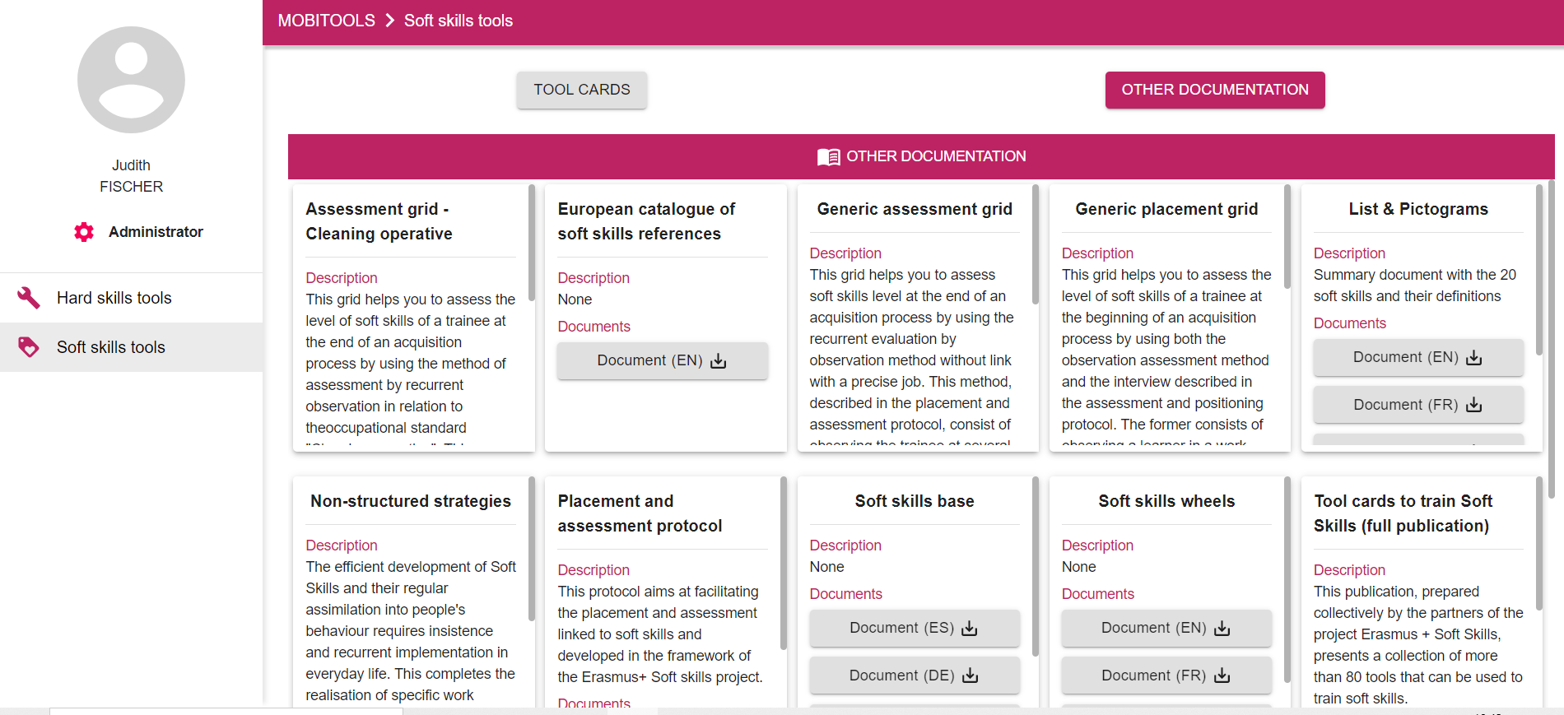
CONSULT ALL OTHER DOCUMENTS
You can view on this page all the ressources that have been developed during the soft skills Erasmus + project
Drag the scroll bar on each document in order to read all the information relating to it (description and documents to download)
Drag the scroll bar to view all the documents
Download the version of the document that interests you by clicking on
1
2

